Slide 1

Тема: Путешествия за рубежом
04.05.2022
Учитель: Киселева С.А.

Slide 2
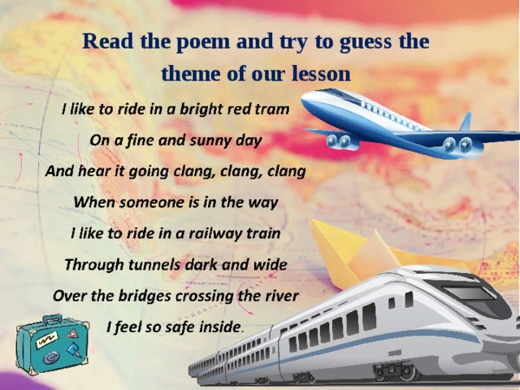

Slide 3
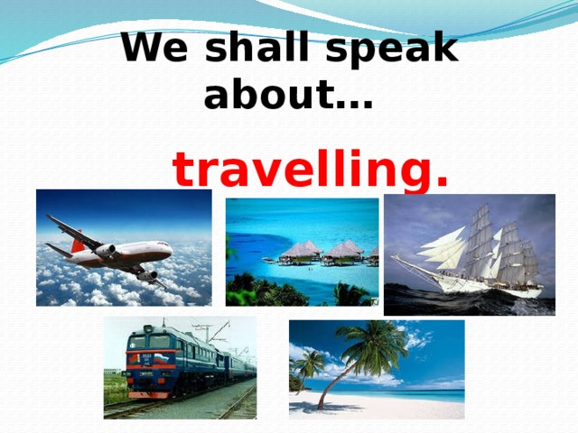

Slide 4
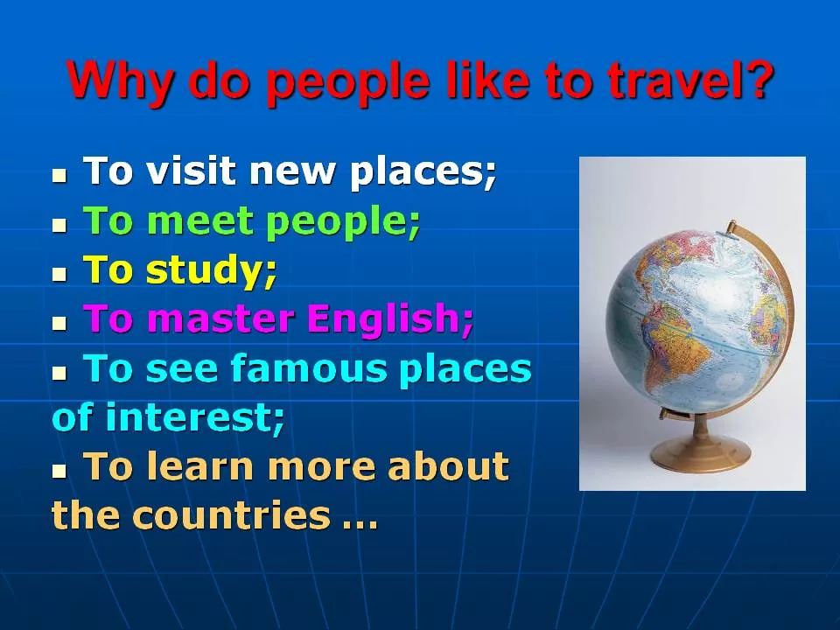

Slide 5
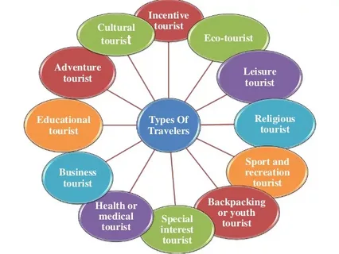

Slide 6
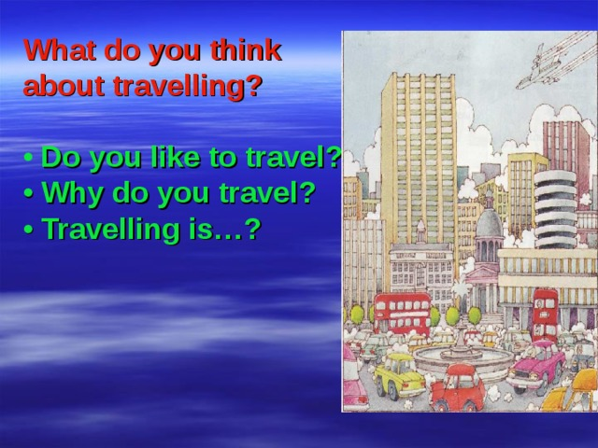

Slide 7
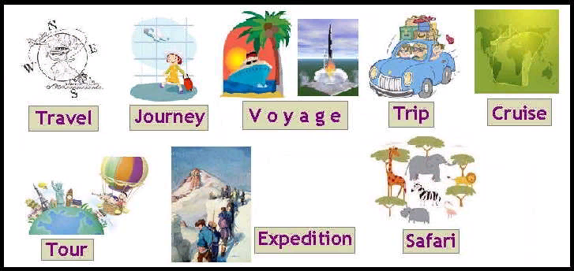

Slide 8
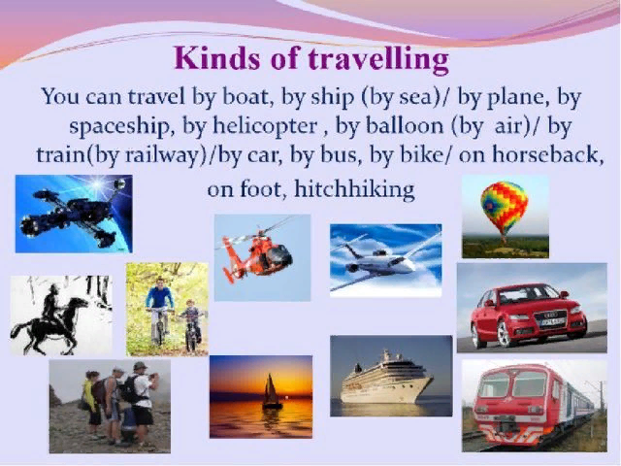

Slide 9
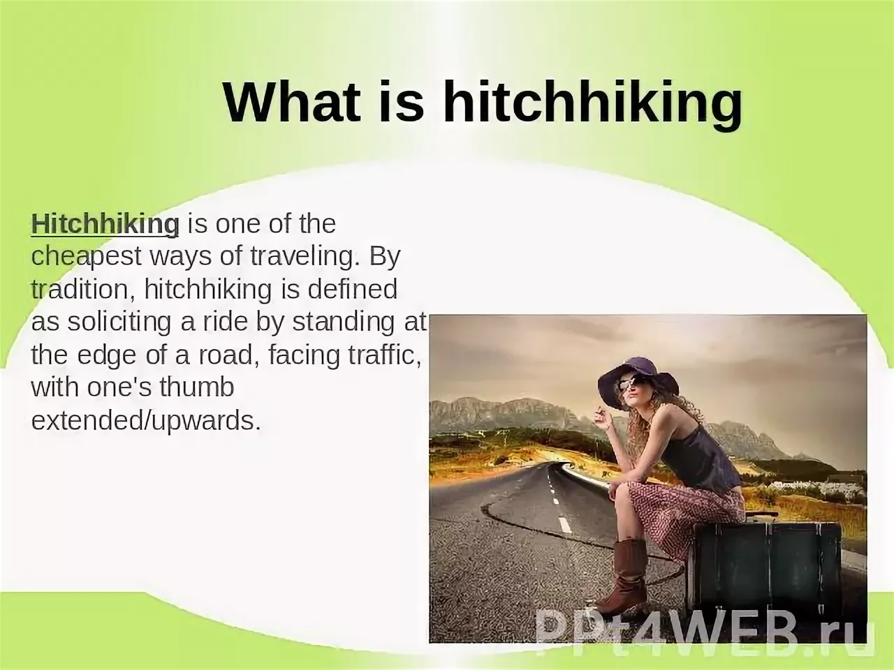

Slide 10
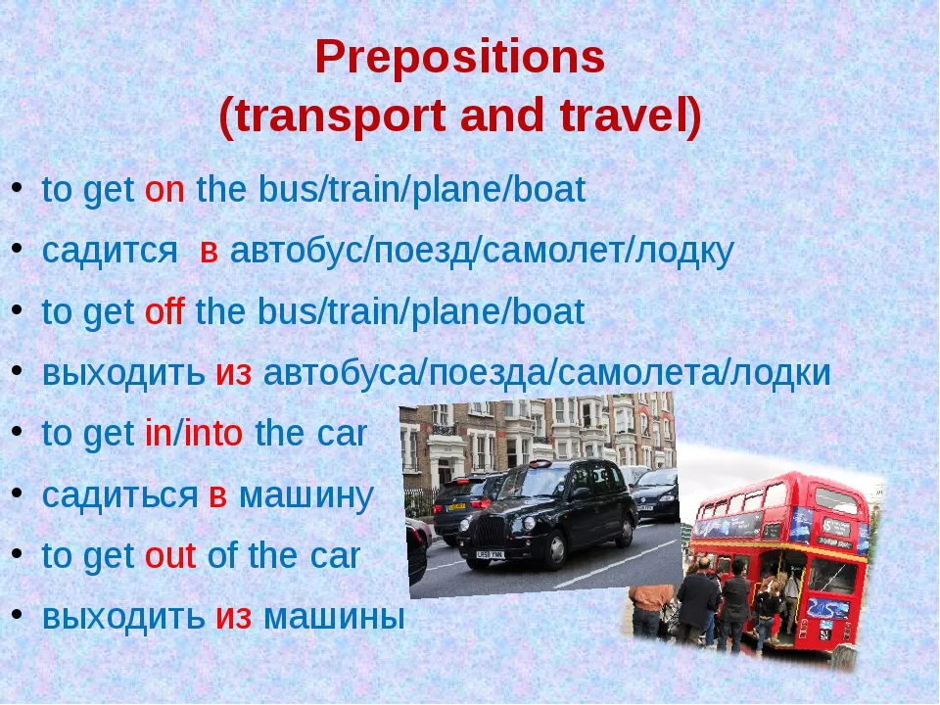

Slide 11
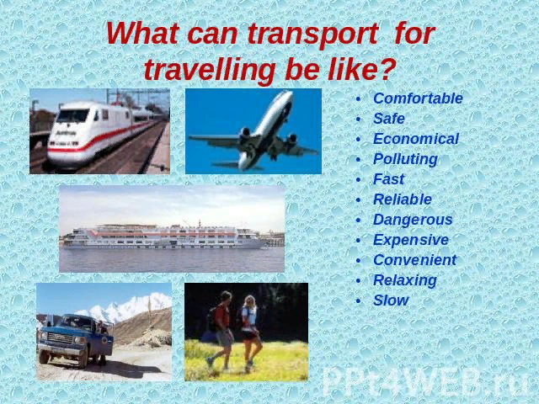

Slide 12
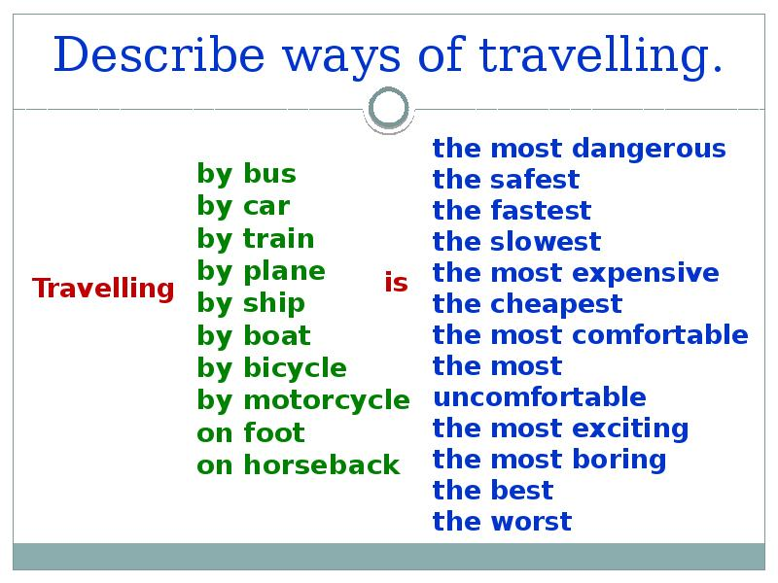

Slide 13
PRACTICE: Rearrange the letters (переставьте буквы) to make words
1. Where is your ……..? (LEGUGGA)
2. My brother loves to travel by …… train. (SAFT)
3. It took him 5 minutes to get to Heathrow …….. (PARITOR)
4. I spent last summer at the ……... (DESISEA)
5. How long does it take you to get to the …….. ………? (IWAARYL ANTISOT)
6. Have you bought a …….. on a 6 o'clock ……..? (CIKTET, RATIN)

Slide 14
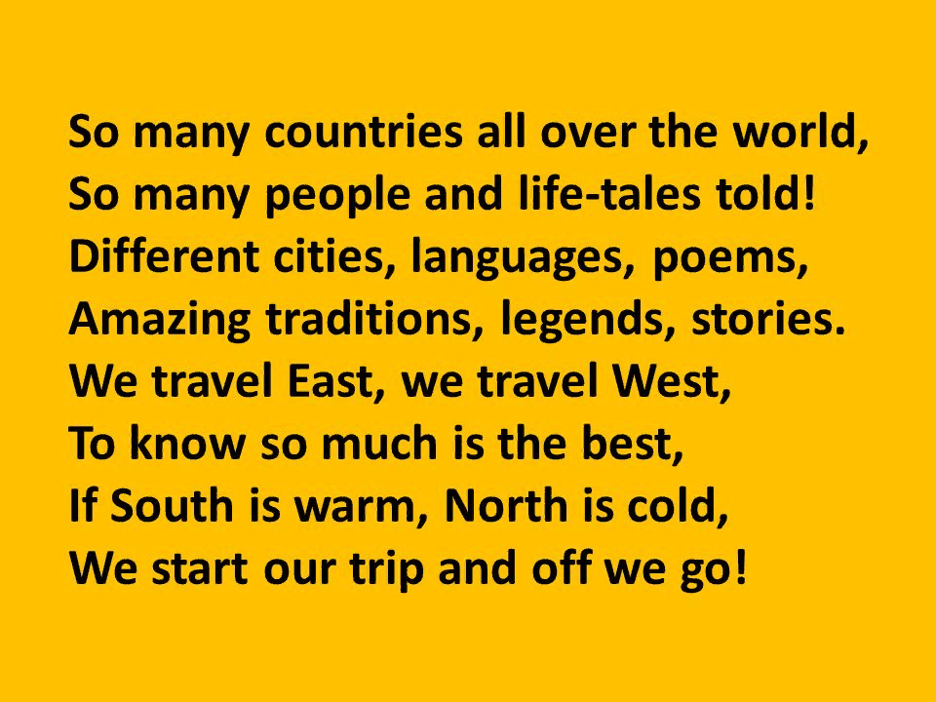

Slide 15
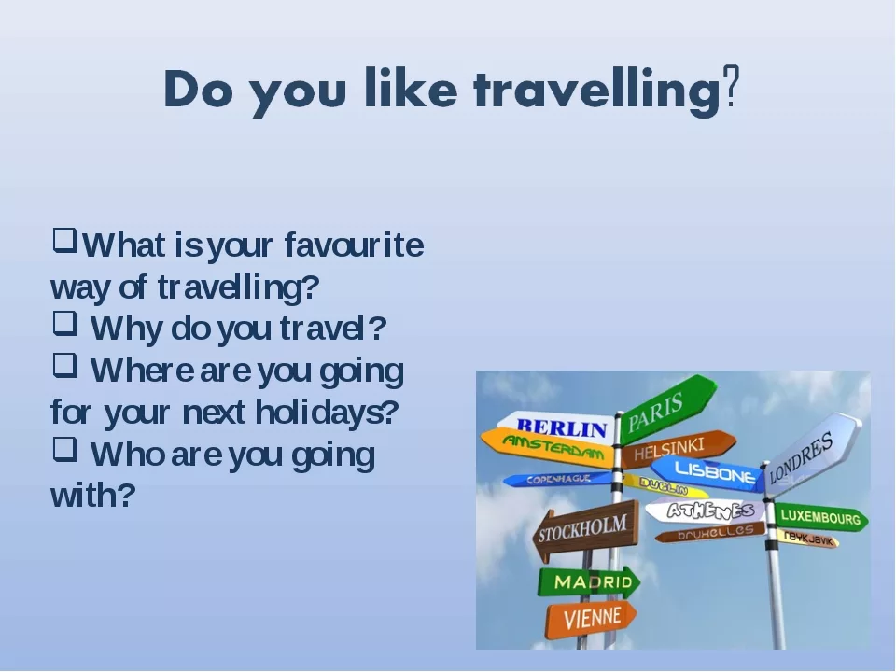
Send completed tasks to my email address www.svetlanakiss1988@gmail.com

